Slide 1

NETWORK PROGRAMMING
Group 3 : Storage

Slide 2
Members
Phạm Anh Hiếu BI9-106
Nguyễn Hoàng Sơn BI10-155
Trịnh Quốc Hiếu BI10-060

Slide 3
Table of content
Introduction
Structure

Slide 4
1. Introduction
Project content
Online storage system :
+ Authentication
+ Load balancer
+ Storage*
+ Client
b. Purpose
Store and return file

Slide 5
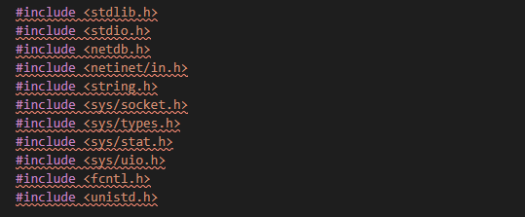
2. Structure
a. Library

Slide 6
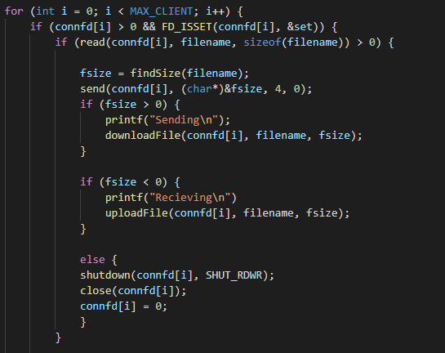
2.Structure
Check request upload/download

Slide 7
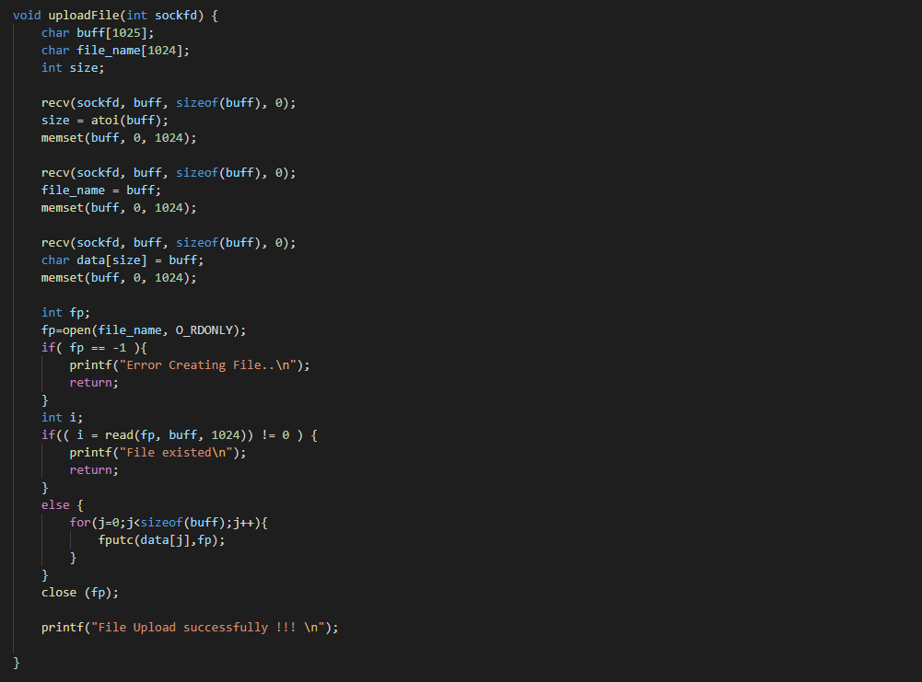
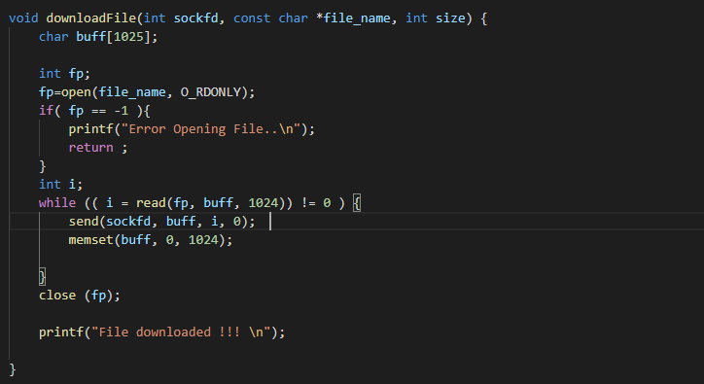
2.Structure
b. Void
downloadFile
uploadFile

Slide 8
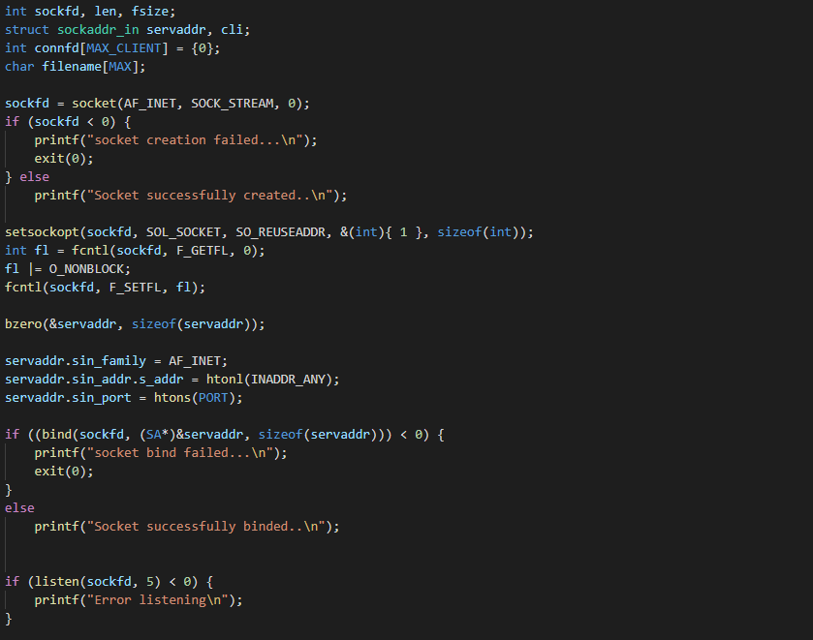
2.Structure
c. Socket
Creating and binding socket

Slide 9
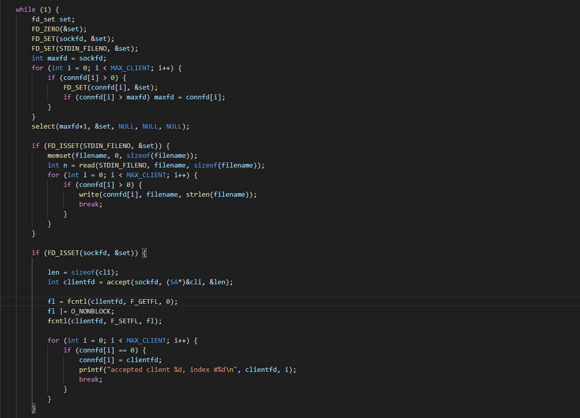
2.Structure
Connect to client

Slide 10
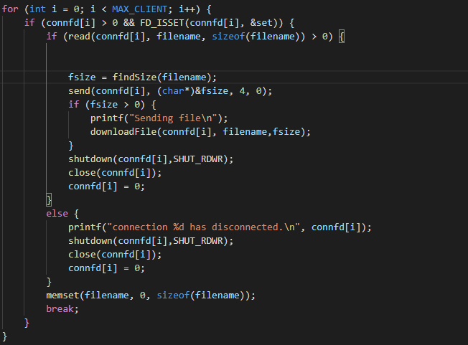
2.Structure
Disconnect

Slide 11


